Slide 1
Analyzing Chemistry-Related YouTube Channels
This project uses YouTube APIs to gather data on the most popular Chemistry-Based Channels on YouTube.
We analyze metrics like their view counts, subscriber counts, and video counts.
We explore what it takes to be a successful Chemistry Channel on YouTube.
Instructions for running the script as well as the full project code can be found on my GitHub.

Slide 2
Part 1: Top Chemistry-Related Channels

Slide 3
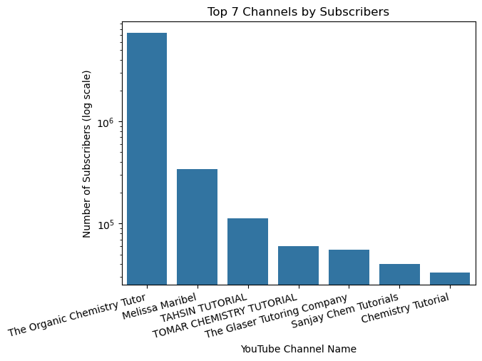
Which Chemistry channels have the most subscribers?
The Organic Chemistry Tutor has the most subscribers by a long shot (~ 7.27 million).
Chemistry Tutorial is at the bottom of the top 7 (~33k subscribers).

Slide 4
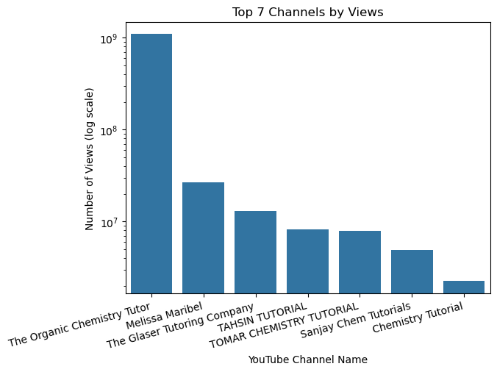
Which Chemistry Channels have the most views?
The same 7 YouTube Channels have the most subscribers AND most views.
Subscribers and views seem correlated - the more subscribers a channel has, the more views.
Exception: The Glaser Tutoring Company
Subscribers < Tahsin and Tomar
Views > Tahsin and Tomar

Slide 5
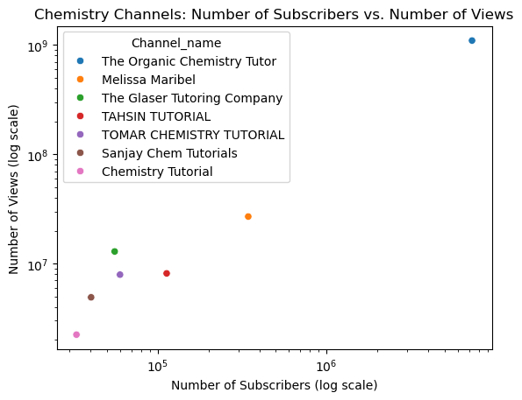
Are Subscribers and Views correlated for Chemistry Channels?
Subscribers and Views seem highly correlated (r = 0.9997)
Would need statistical testing to see if correlation is statisti-cally significant.

Slide 6
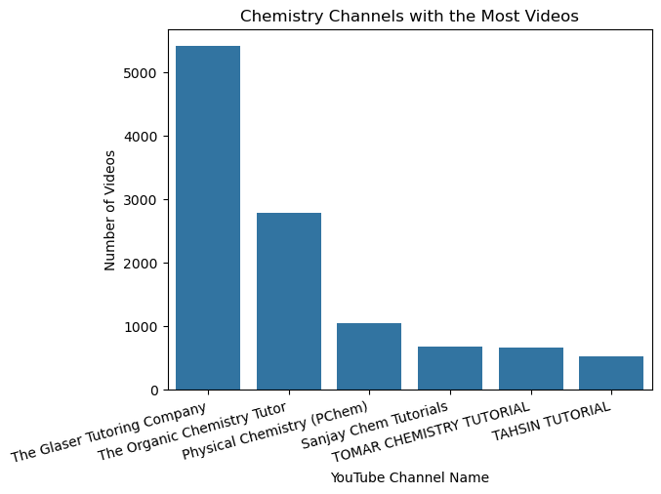
Which Chemistry Channels have the most Videos?
It seems video count is NOT correlated with view and subscriber count.
The Organic Chemistry Tutor:
# videos = ½ videos by Glaser
Yet # views = 85x Glaser’s views and subscribers = 130x Glaser’s subscribers.
Melissa Maribel =/= top 6 channels with most videos.
Physical Chemistry (PChem)
Top 7 for most videos
Not Top 7 for views or subscribers
Perhaps Quality of Videos = more important

Slide 7
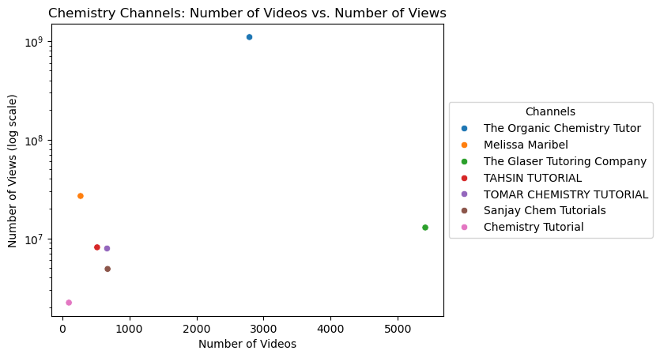
Are Num of Views and Num of Videos Correlated?
Num of videos and views seem weakly correlated (R= 0.2955).
Need statistical testing to confirm significance.
Do those channels that have been around longer = have more views and subscribers? (Future analysis)

Slide 8
Part 2: Top Chemistry-Related Channel = The Organic Chemistry Tutor (“TOCT”

Slide 9
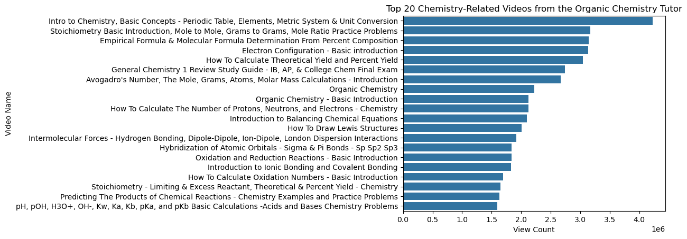
What are the Top 20 Videos by TOCT?
TOCT’s top video has ~1 million more views than that of its second most popular video.
This video could be so popular because it goes over basic concepts that lay the foundation for chemistry.

Slide 10
What are the Top 20 Videos by TOCT? (cont’d)
After that, the most popular videos seem to be tutorials on the following topics:
Stoichiometry and Molar Calculations
Determining Empirical and Molecular Formulas
Electron Configurations
Calculating Theoretical Yield and Percent Yield
Predicting products of Chemical Reactions & Balancing subsequent Chemical Equations
Drawing Lewis Structures
Bonding: Ionic, Covalent, and Intermolecular Forces
Reduction-Oxidation Reactions
Basic Acid-Base Reaction Calculations
If I were to start my own channel: may be wise to create tutorials on similar foundational topics.

Slide 11
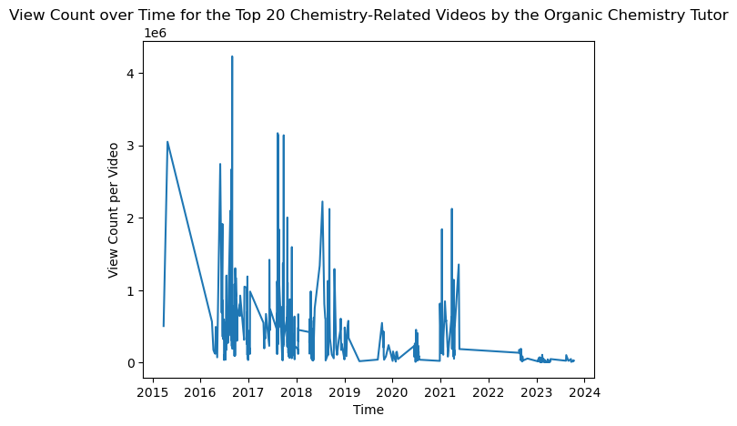
What is TOCT’s View Count over Time?
Video popularity = a cyclical pattern 2016-18
Any videos published after in 2022-23 have had consistently lower views (thousands).
Perhaps skyrocketing views related to COVID-19 pandemic:
Videos published before 2020 = greater opp to skyrocket b/c greater need for them in 2020 and 2021.

Slide 12
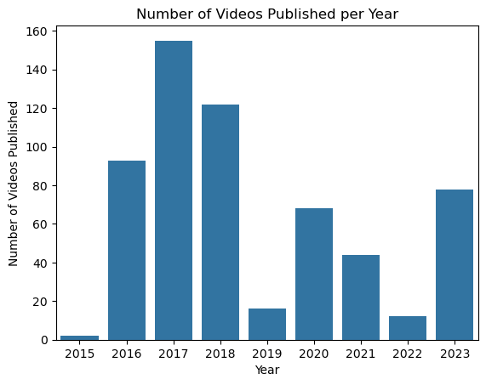
How many videos does TOCT post/year?
Least active year was 2019 (<20), with more new videos again in 2020 and 2021 (40-80/yr).
Maybe TOCT posted more videos in 2020, b/c 2016-2018 videos took off during the pandemic (2020-21).
Perhaps skyrocketing views encouraged TOCT to post more videos in 2020 and 2021, after posting very few in 2019.
It would be interesting to see view counts for his 2016-2018 videos in 2019 (pre-covid)
Did TOCT’s popularity truly skyrocket with the onset of COVID-19 pandemic?

Slide 13
Conclusions
The Organic Chemistry Tutor = most successful Chemistry-related YT Channel by a lot.
Num of subscribers and num of views seem highly correlated (r=0.9997). Statistical testing likely not necessary.
Num of videos and num of views seem weakly correlated (r=0.2960). This suggests quality of videos = bigger influence on views than quantity. Could perform statistical testing, but conclusion seems reasonable.
The Organic Chemistry Tutor's most popular videos are on foundational chemistry topics.
The Organic Chemistry Tutor's most popular videos were published between 2016-2018. Perhaps onset of COVID-19 pandemic (2020) allowed for rise in views for these videos. Would be cool if we could access view count data from 2019 – did he really take off after COVID-19 pandemic?
Perhaps the impact of the pandemic on TOCT’s views may have encouraged him to post more content in 2020, after posting less in 2019. Perhaps he felt more incentive to keep his channel going after he gained mass popularity.

